Slide 1
Movie Recommender System -Team Whatflix-
ByungHyun Lee
JunYeong Ahn
JiHong Jeong

Slide 2


Goal
‘To develop unique movie recommendation system,
mainly based on similarity analysis’
genres & ratings history
ratings
<Input>
<Output>

Slide 3
Goal
‘To develop unique movie recommendation system,
mainly based on similarity analysis’
genres & ratings history
ratings
<Input>
<Output>

Slide 4
Structure of the System
Cold Start problem
Full data
Survey & Web crawling
Rating of the user
Data A for user
Data B for movie
Recommend ‘top 5’ movies
to the user
User-based CF
Movie-based CF
Data
Feature creation
H.P
Pre-processing
ML
‘Rating’ regression using
XGBoost
Feature selection
Modeling

Slide 5
Today
Cold Start problem
Full data
Survey & Web crawling
Rating of the user
Data A for user
Data B for movie
Recommend ‘top 5’ movies
to the user
User-based CF
Movie-based CF
Data
Feature creation
H.P
Pre-processing
ML
‘Rating’ regression using
XGBoost
Feature selection
Modeling

Slide 6
XGBoost

Slide 7
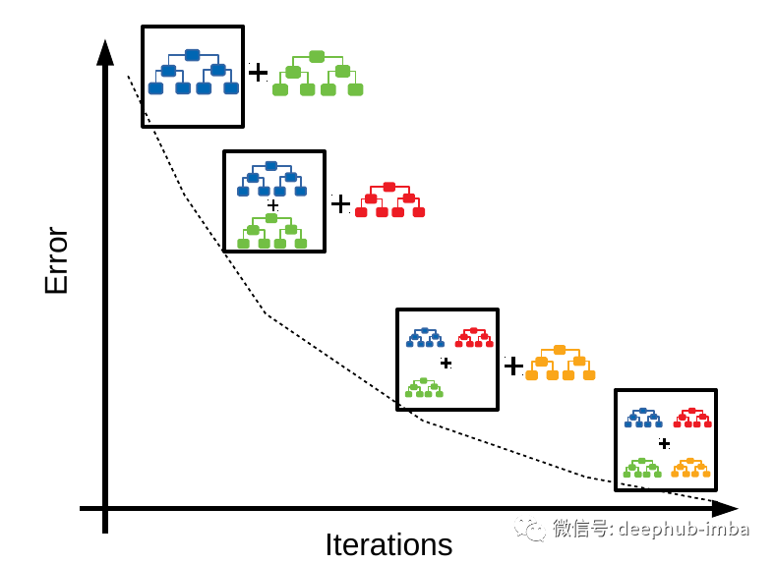
What is XGBoost?
A decision-tree(DT)-based ensemble ML algorithm
that uses a Gradient Boosting
Multiple DTs – not all at once, but one by one
Sequential iterations toward minimized error
- Boosting

Slide 8
Why XGBoost?
Linear vs. Tree-Based vs. Deep Learning
XGBoost means ‘VERY QUICK’!
Tree-Based
Linear
Deep Learning
-Good interpretability
-Linear assumption
-Black Box
-Robustness

Slide 9
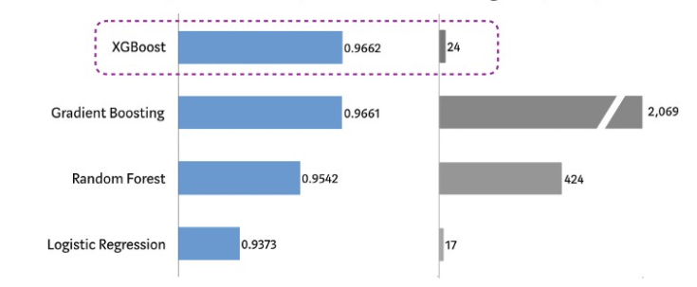
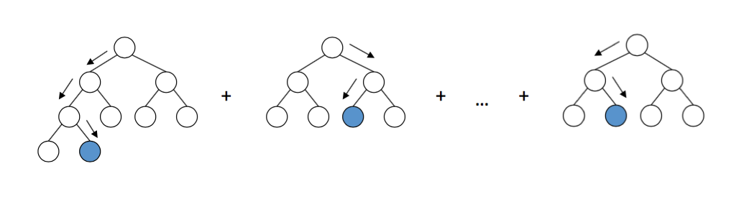
Why XGBoost?
Linear vs. Tree-Based vs. Deep Learning
XGBoost means ‘VERY QUICK’!
<performance>
<run-time>
‘max_depth’
,,, Let’s ML!

Slide 10
XGBoost Modeling
- Cosine Similarity-
Target
Features

Slide 11
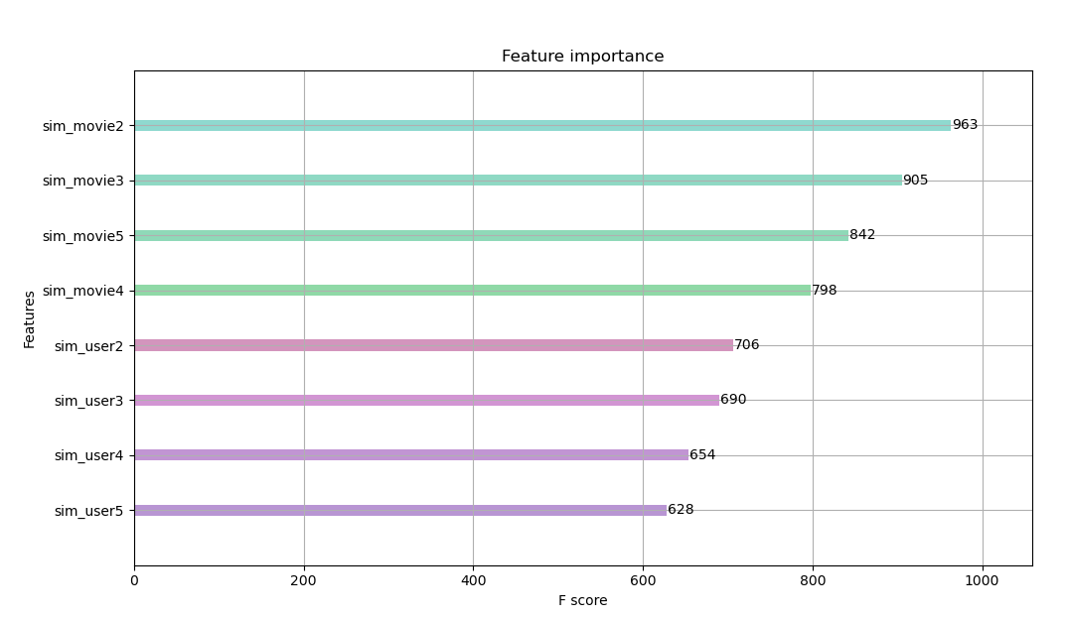
Feature Importance – cosine similarity

Slide 12
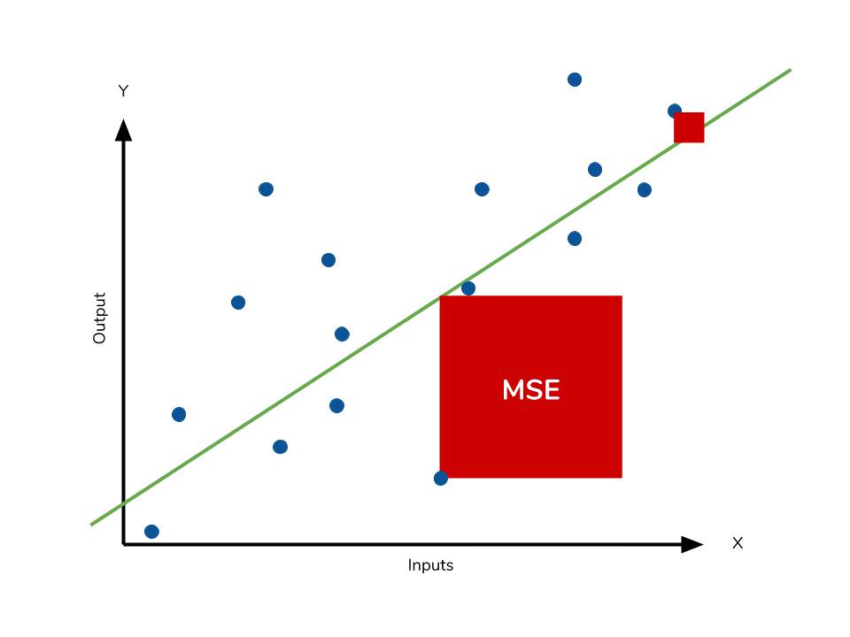
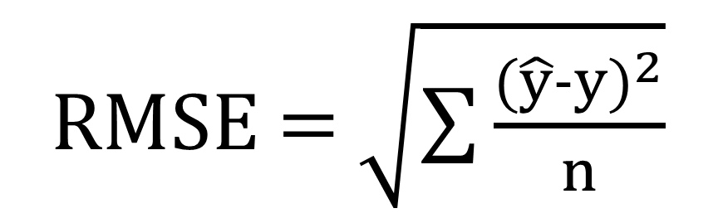
Model Evaluation – cosine similarity
RMSE(Root Mean Square Error)
RMSE = $\sqrt{\sum{\frac{{(\hat{y}−y)}^{2}}{n}}}$

Slide 13
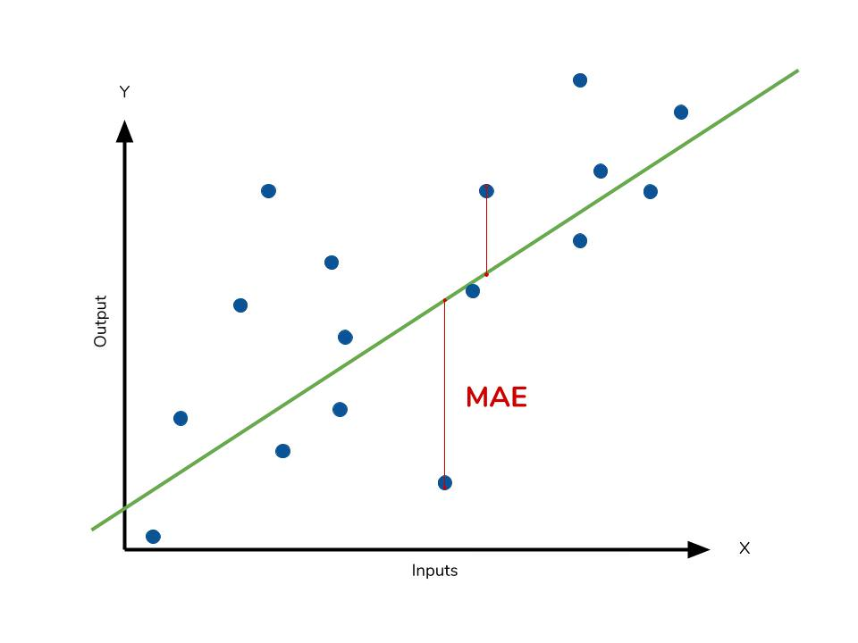

Model Evaluation – cosine similarity
MAE(Mean Absolute Error)
$MAE$ = $\frac{\sum{\left|y−\hat{y}\right|}}{n}$

Slide 14
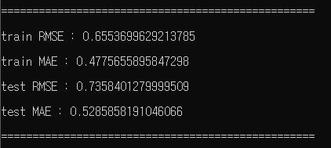
Model Evaluation – cosine similarity

Slide 15
XGBoost Modeling
- Pearson Correlation -
Target
Features

Slide 16
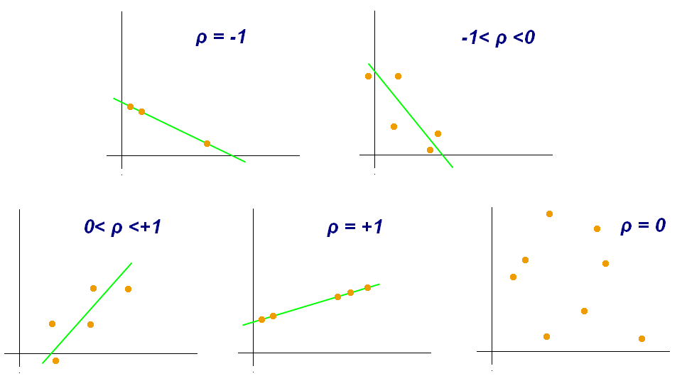




Pearson Correlation Coefficient
A statistic that measures linear correlation between two variables X and Y
is the covariance
is the standard deviation of
is the standard deviation of

Slide 17
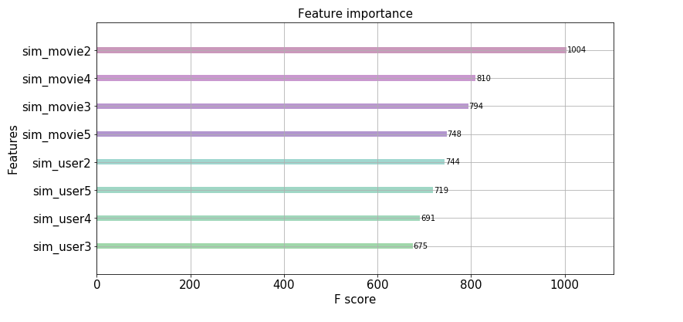
Feature Importance – pearson correlation

Slide 18
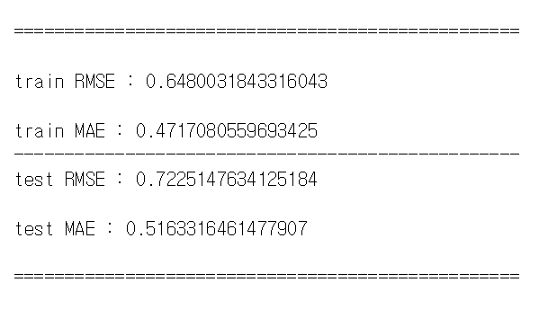
Model Evaluation – pearson correlation

Slide 19
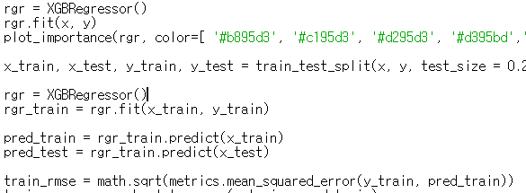
So Far, Dull Model
DEFAULT!

Slide 20
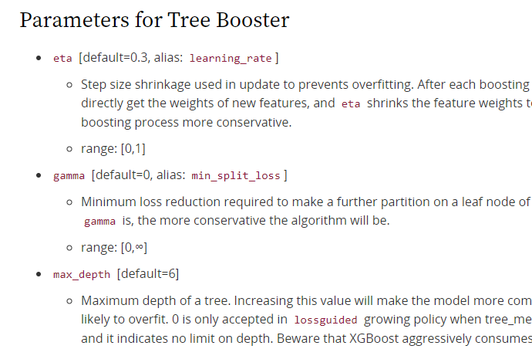
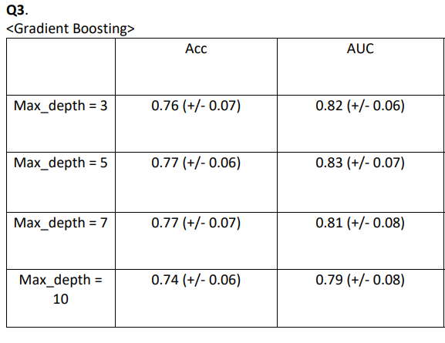
The Next Time
<Hyperparameter Tuning>
...

Slide 21
GANTT Chart
Date | 30 | 1 | 2 | 3 | 4 | 5 | 6 | 7 | 8 | 9 | 10 | 11 | 12 | 13 | 14 | 15 | 16 | 17 | 18 | 19 | 20 | 21
WP1
WP2
WP3
WP4
WP5
Presentation
Weekly summary
Milestone |  |  |  |  |  | 1 |  |  |  | 2 |  |  |  |  |  |  | 3 |  |  |  |  | 3
M1: CFs constructed
WP1: Understanding on given data & EDAs
WP2: Pre-processing
WP3: Feature selection & creation
WP4: Modeling with some tuning
WP5: Analysis & evaluation
M2: data prepared
M3: model trained
M4: recommender completed

Slide 22
Thank you for your attention :)

